Slide 1
US Ignite
Jonathan Wang, Yachen Guo, Ananya Raghupathy, Chengyuan Zhang, Satvik Kumar, Adithi Reddy Kallem

Slide 2





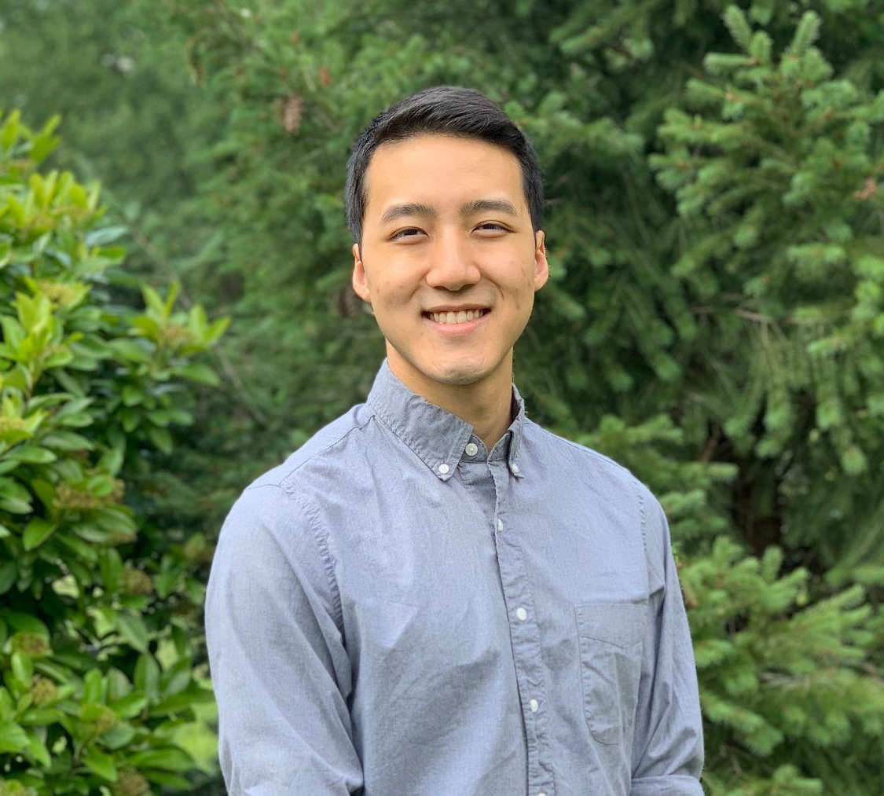
The Team
Adithi Reddy Kallem
MISM BIDA 16
Chengyuan Zhang
MISM General 16
Yachen Guo
MISM BIDA 16
Satvik Kumar
MISM General 16
Ananya Raghupathy
MISM BIDA 16
Jonathan Wang
MISM General 16

Slide 3

Background
Non-profit research organization accelerating the smart cities movement with more than 160 federal, municipal, industry and academic partners.
For over ten years, US Ignite has worked closely with many federal agencies to help cities curate roadmap towards their smart city challenges.

Slide 4
Problem Statement
The primary use case is ‘inclement weather decision support’ - when future inclement weather is forecasted, the Fort Carson Garrison Command may understand ahead of time how this would affect commuting safety onto and off of the base.
This will in turn allow them to make more data-driven decisions on whether to delay opening of the base, close it early, or reduce it to mission-essential personnel only for a given day.
We will be responsible for identifying a practical methodology for modeling the transportation impacts of inclement weather to support this decision making process.
In summary, we need to define a “safety metric” for Fort Carson’s nearby major roads.

Slide 5
Existing Research
US Ignite is currently working on a Poisson Regression model to categorize a road as safe or unsafe.
Previously there was work done to estimate the congestion on a road and the likelihood of a crash.

Slide 6
Scope of Work
Research and gather data related to commute safety.
Define regional-specific safety metric for commuting on and off Fort Carson Garrison Command.
Develop a model for commute safety measurement to provide support for inclement weather decision at Fort Carson Garrison Command.

Slide 7
Anticipated Milestones
Milestone 1: Research and Define the safety metric.
Milestone 2: Model the safety metric.
Milestone 3: Compare it to US Ignite’s baseline model.
Milestone 4: Fine-tune the model.

Slide 8



Overview of Resources
Waze Data
Colorado Department of Transportation Crash Data
Open Weather API

